Slide 1
Syllabus IHE Groundwater Flow
Transient Analytical Solutions
Prof.dr.ir.T.N.Olsthoorn, 2017

Slide 2
Transient groundwater flow:
Only if some form of storage is available
Without storage pressures would spread at (almost) infinite speed, --- the flow system would be steady
Every physical system shows at least initially some dynamics in storing energy, momentum or mass

Slide 3
Groundwater systems
Some systems react fast
Others react extremely slowly; it may take hundreds or even thousands of years before an equilibrium is finally reached
For example: Kalahari, > 10000 years
Small parcel between ditches, 2 days

Slide 4
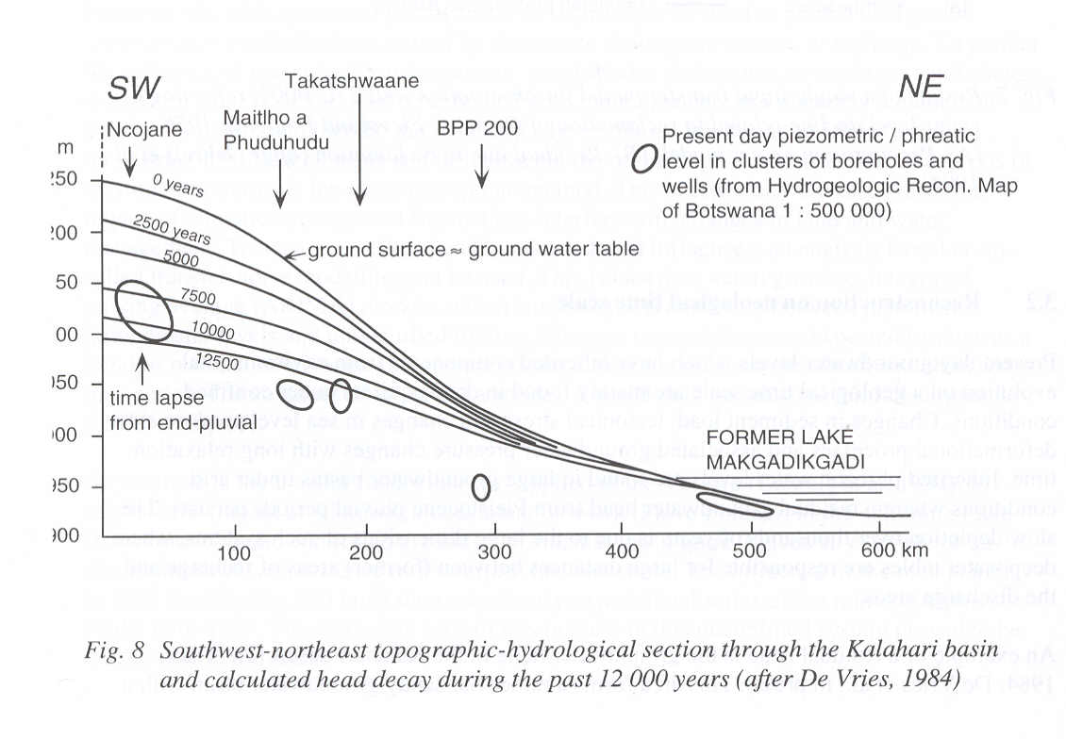

Slide 5
Forms of subsurface storage
Irreversible storage
Reversible storage
Water table storage
Elastic storage

Slide 6
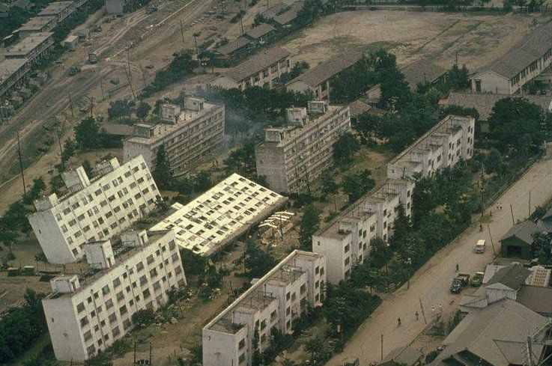

Slide 7
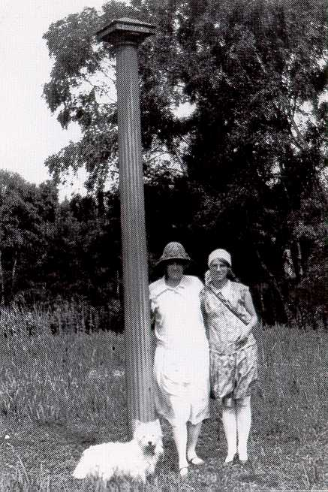

Slide 8
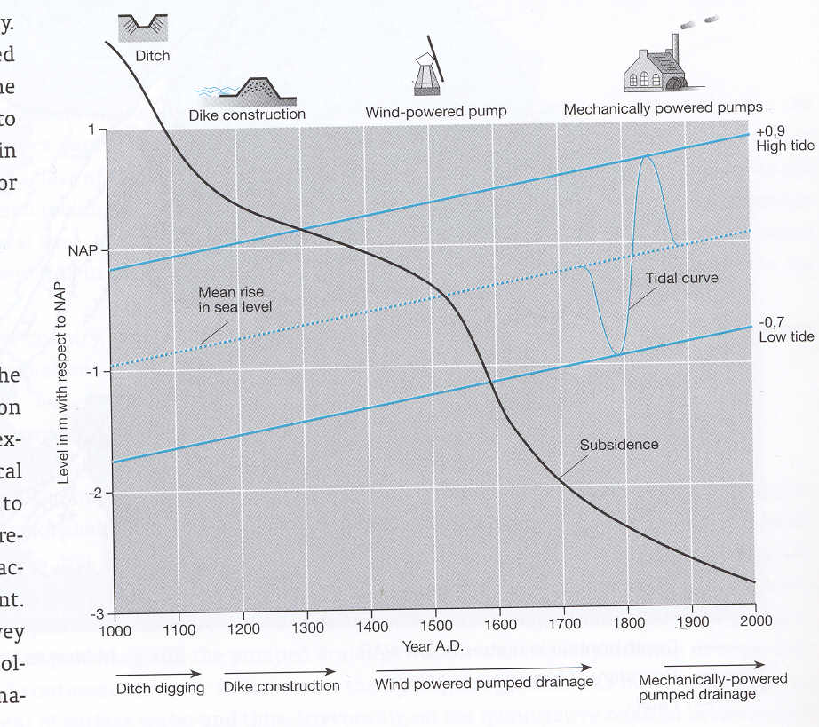

Slide 9
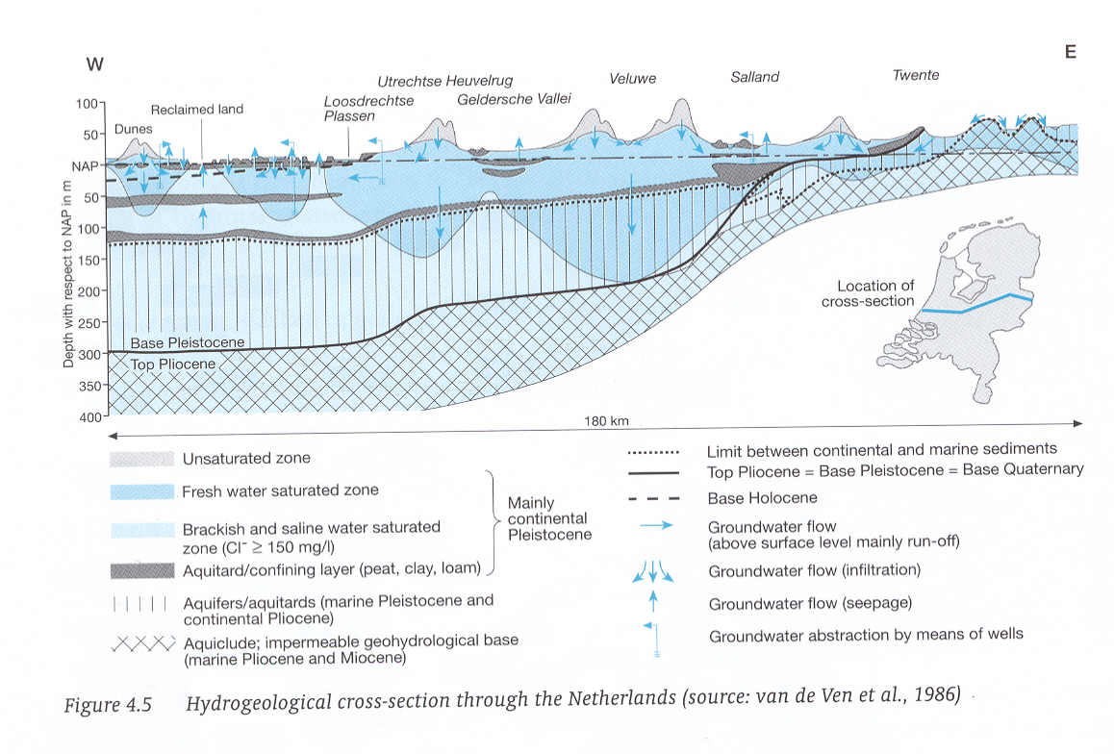

Slide 10
Variations in storage (water mass in aquifers) possible because
Elastic behavior of water, grains and especially the grain matrix
Storing of water above the water table
(Sometimes compression of gas – petroleum engineering)

Slide 11
Forms of storage

Slide 12
Phreatic storage
Unsaturated zone
pF-curves
Specific yield

Slide 13
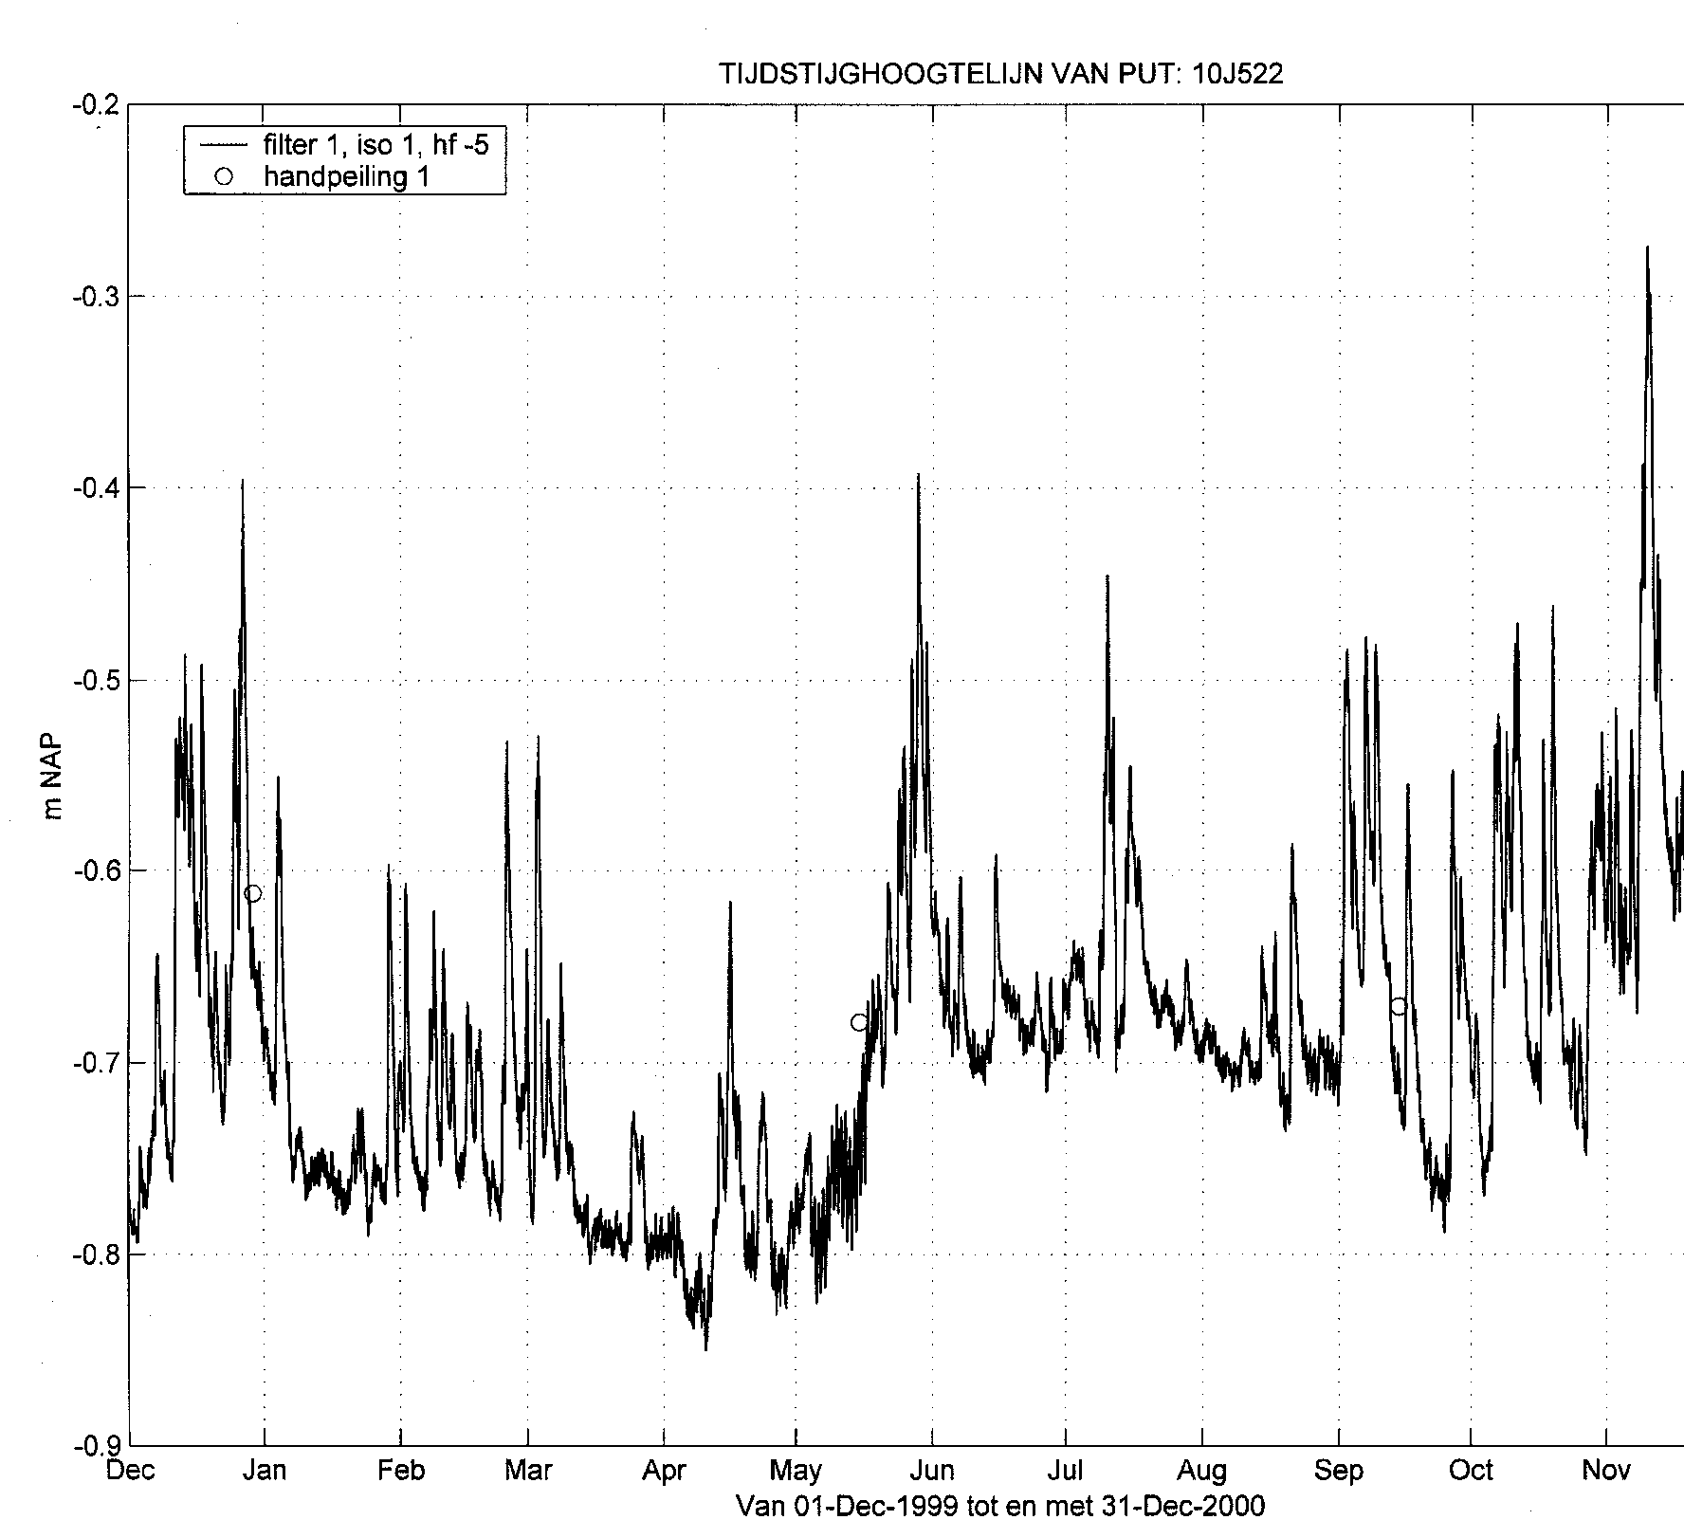

Slide 14
Capillarity
α
r
R
Meniscus
=
sphere
(
must
be
)
compare
with
half
sphere
h
p
=
−
ρ
gz
c
z

Slide 16
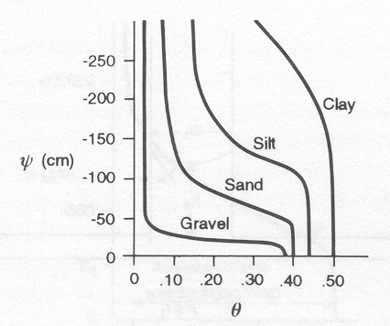

Slide 17
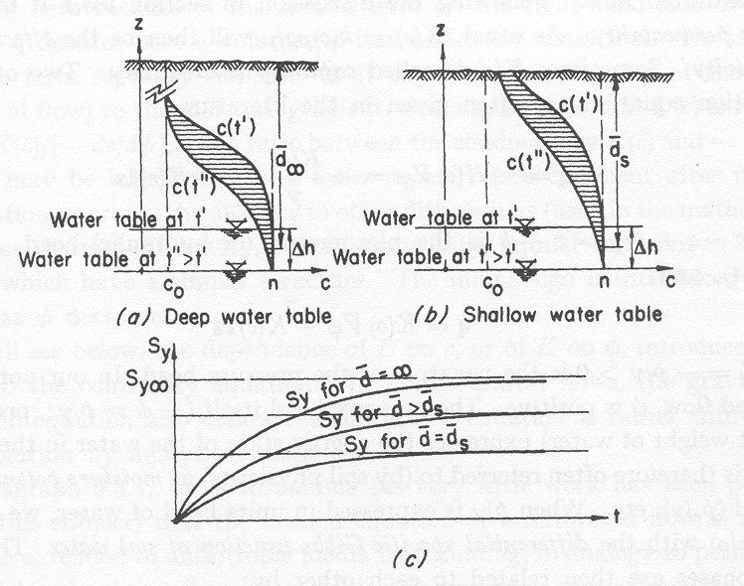

Slide 19
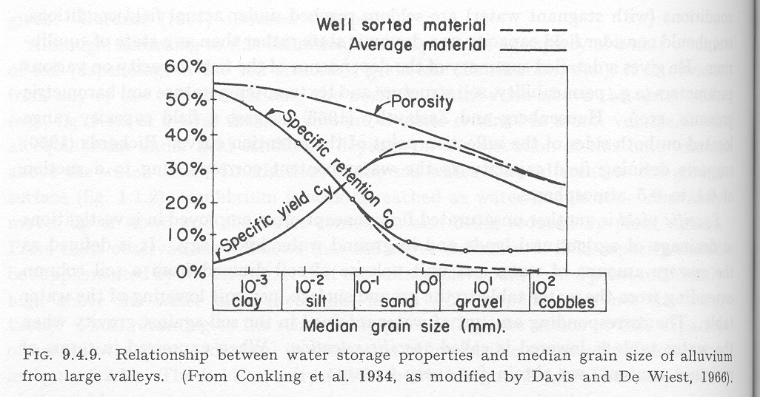
Specific yield

Slide 20
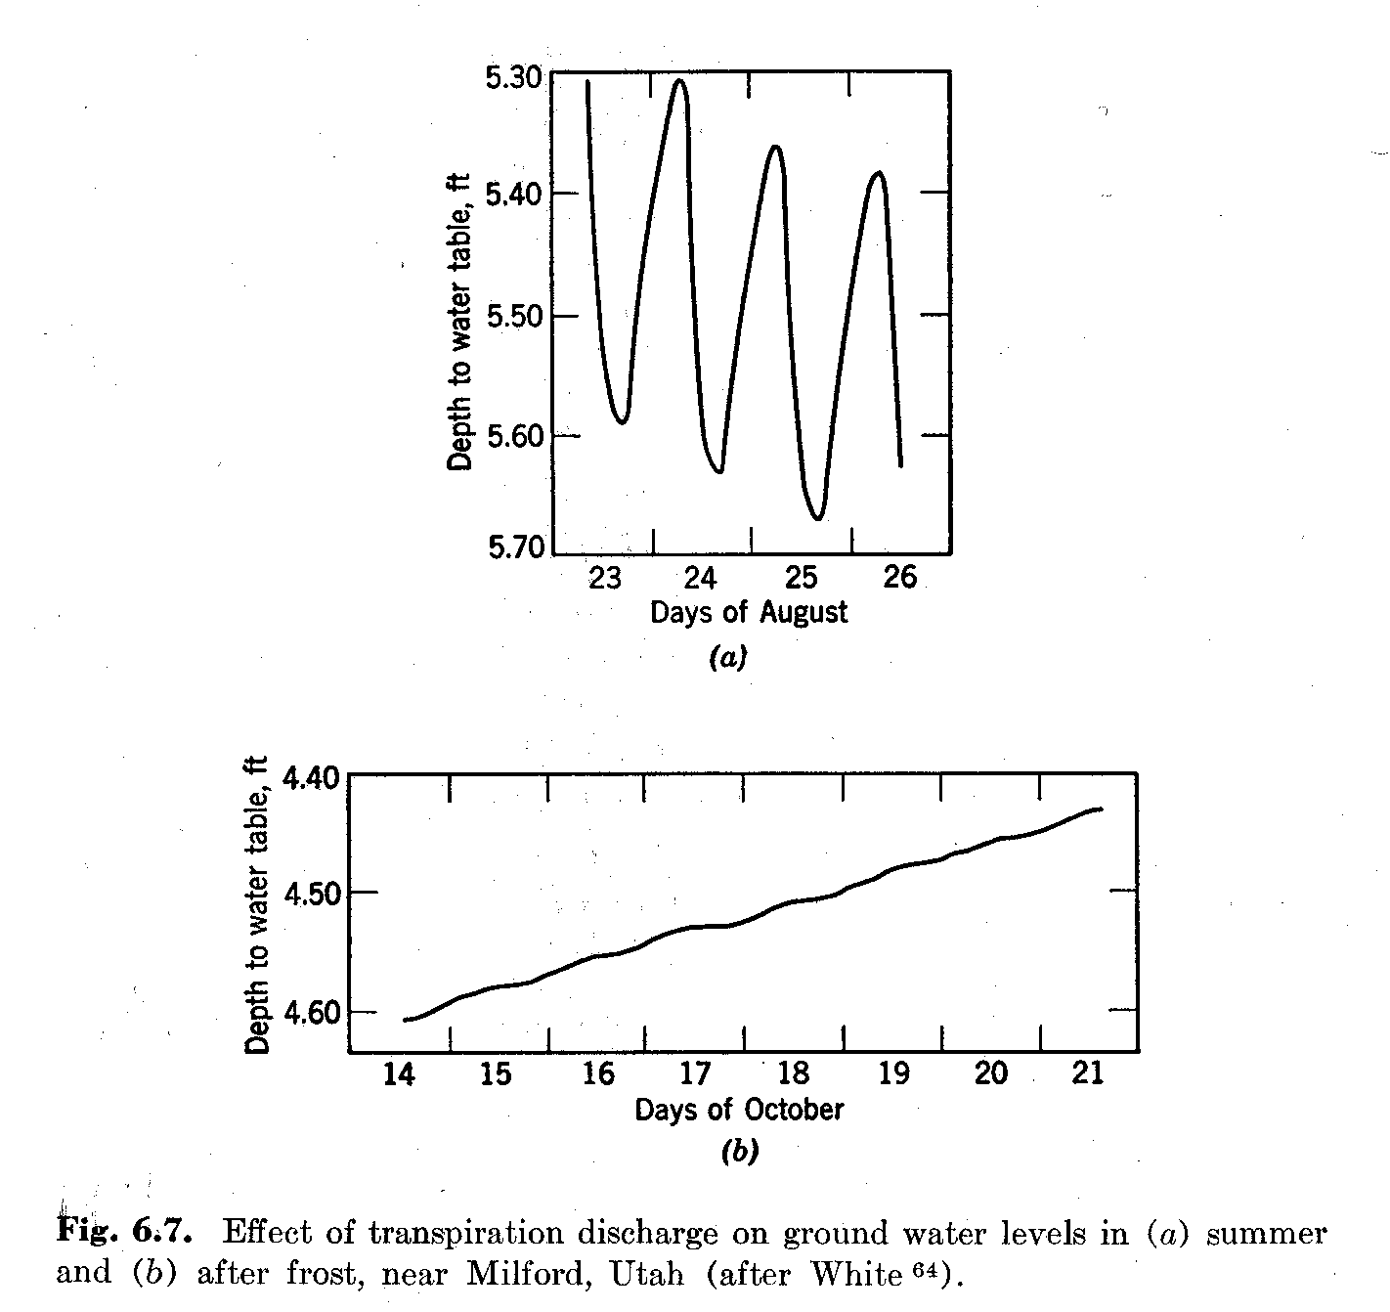

Slide 21
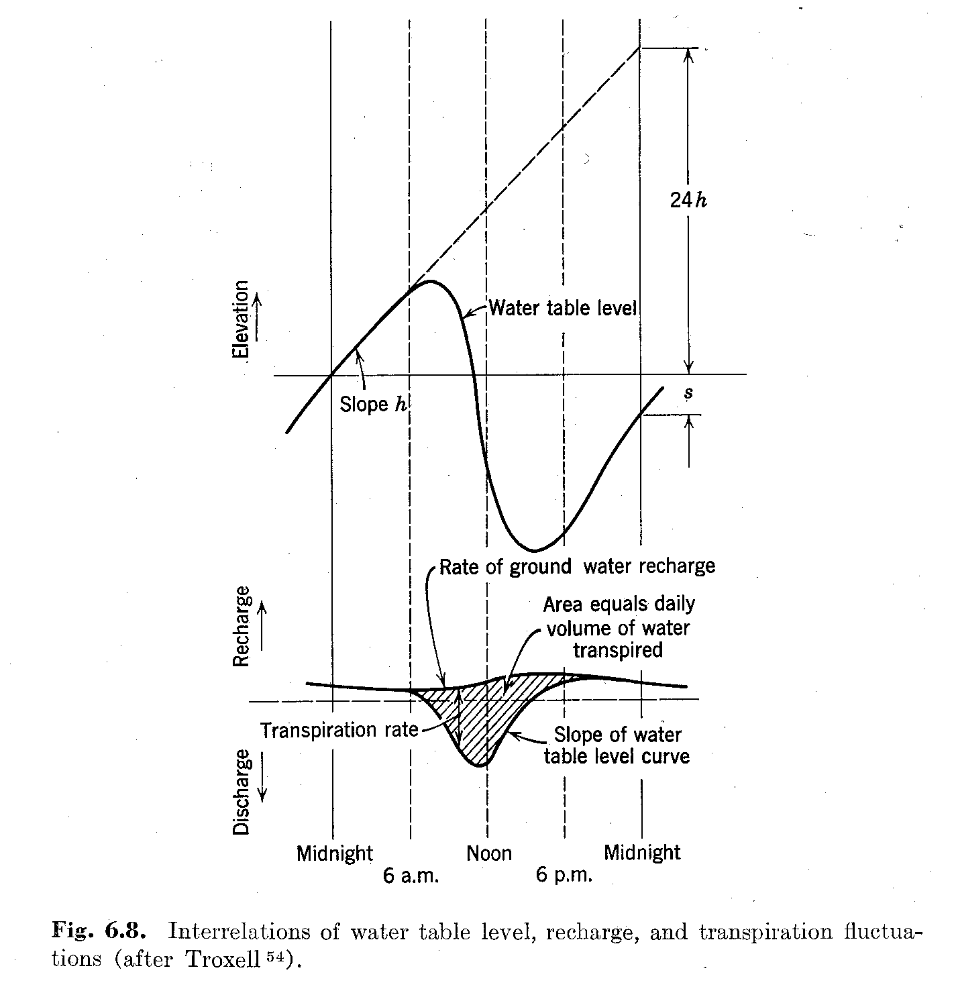

Slide 23
Elastic storage (semi)-confined aquifers
Specific (elastic) storage S_{s}
Elastic storage of aquifer S
Barometric efficiency
Loading efficiency
Earth tide

Slide 24
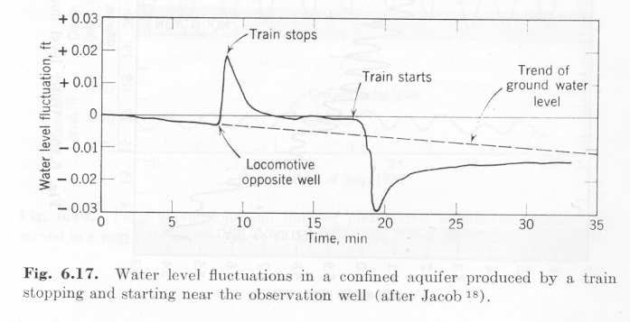

Slide 25
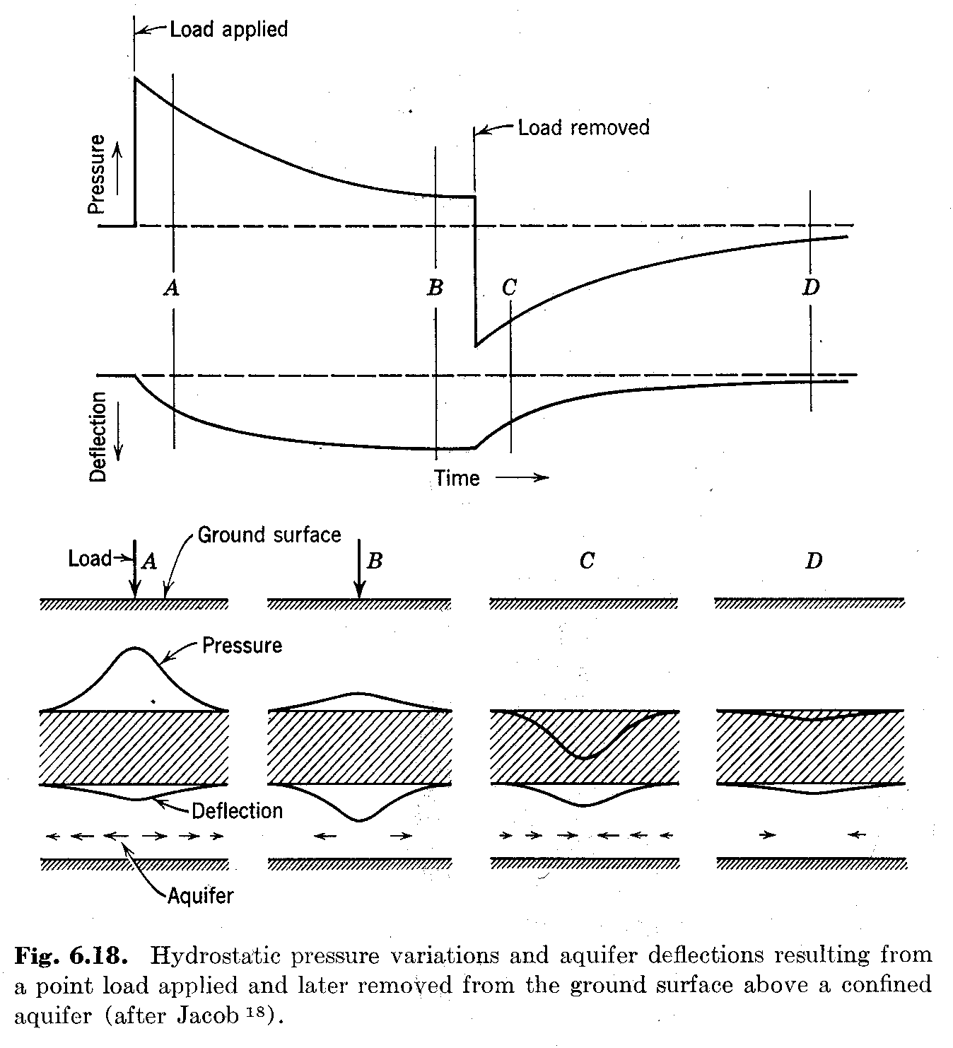

Slide 26
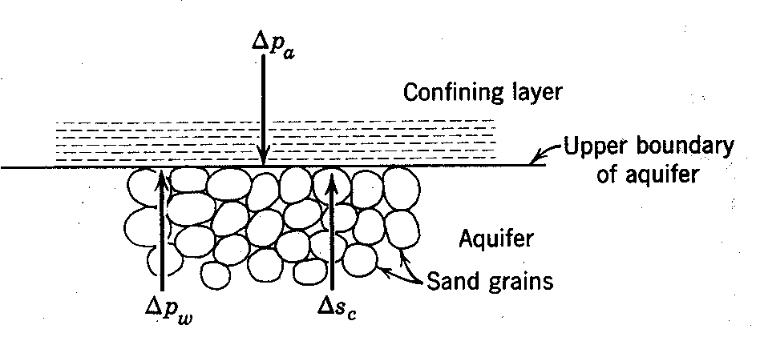

Slide 27
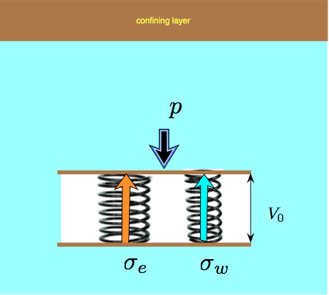

Slide 28
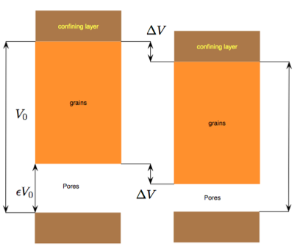

Slide 29
Pressure changes in and on the soil
Change in overburden
Loading
Tides
Change in atmospheric pressure
Note: These pressure changes only affect heads in (semi)confined aquifers !

Slide 30
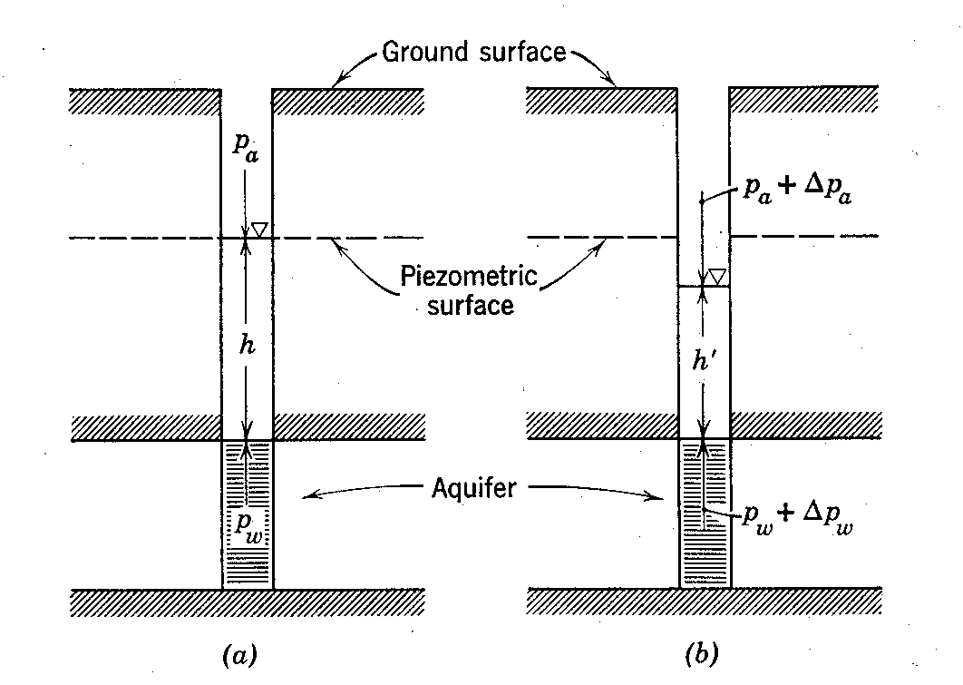

Slide 31
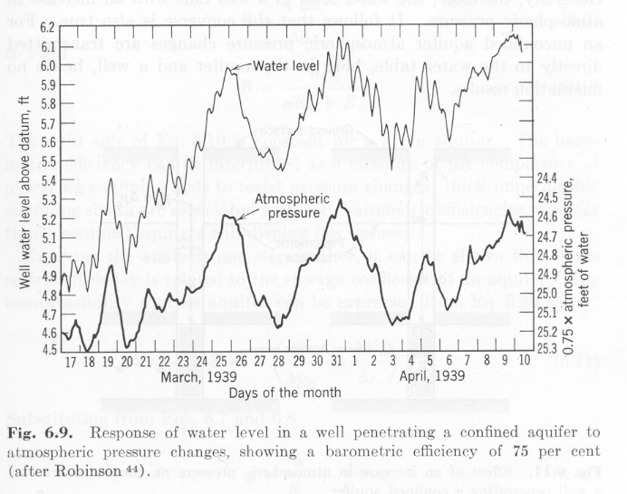

Slide 32
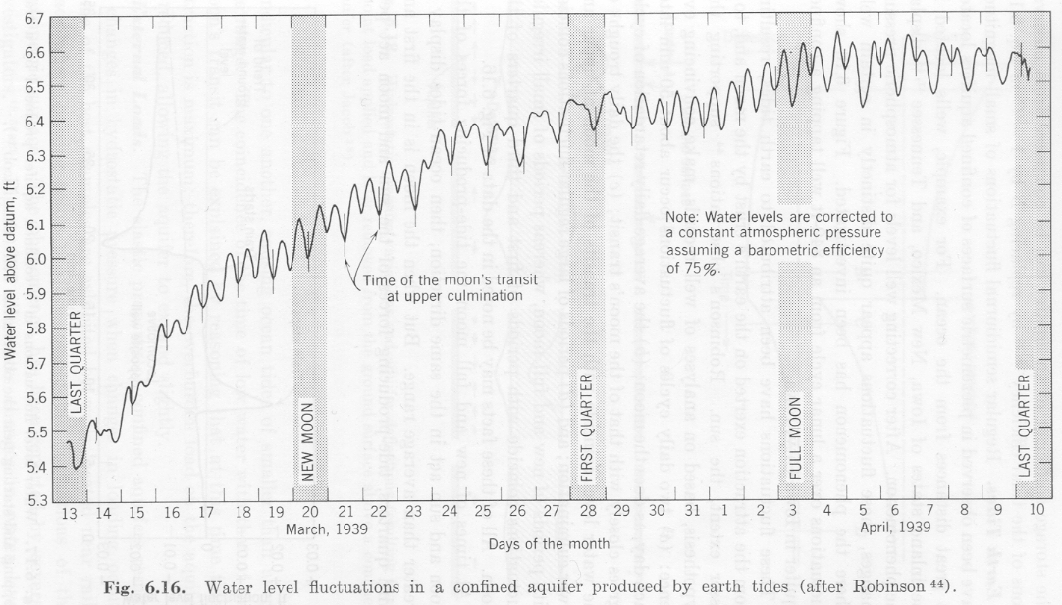

Slide 33
Difference in amount of water from phreatic and confined aquifer storage
Phreatic aquifer
Confined aquifer
Initial water table
Initial head
Drawdown
Dh
Final head
Drawdown
Df
Final water table
impervious
impervious
V=S_{y}Dh
V=SDf

Slide 34
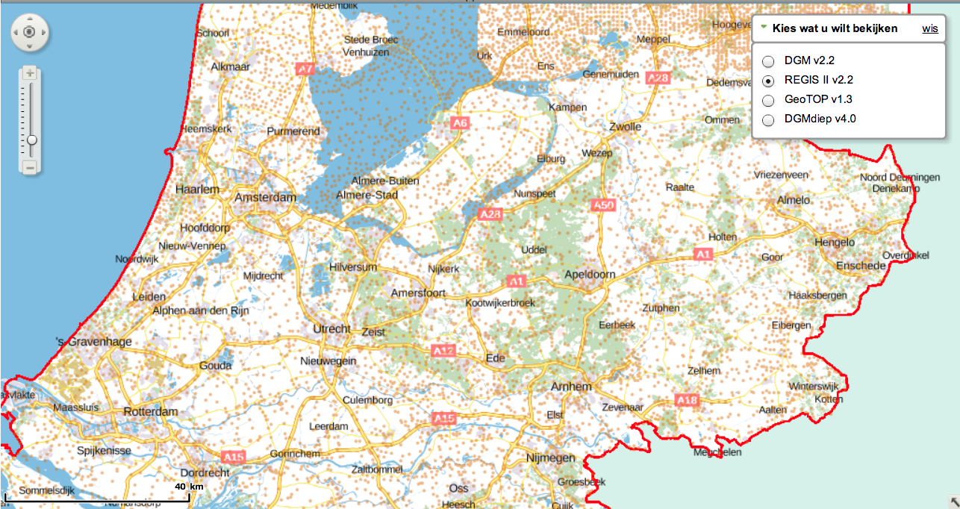

Slide 35
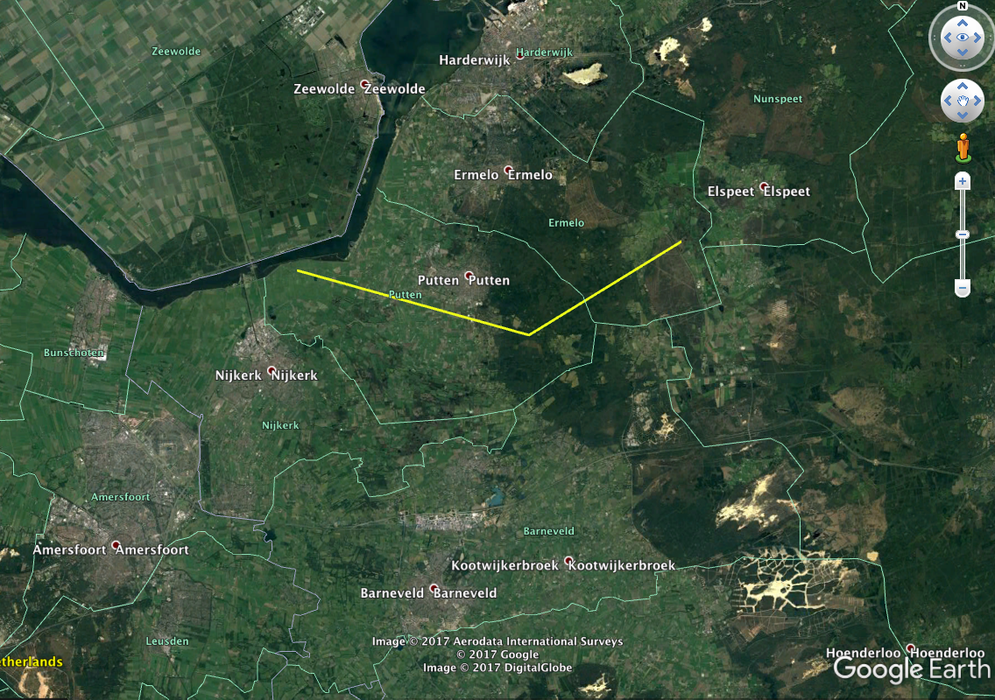

Slide 36
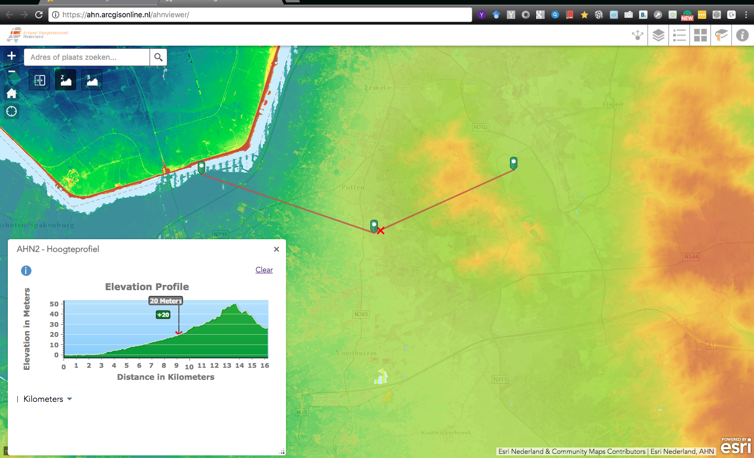

Slide 37

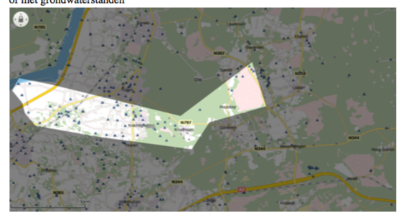

Slide 38
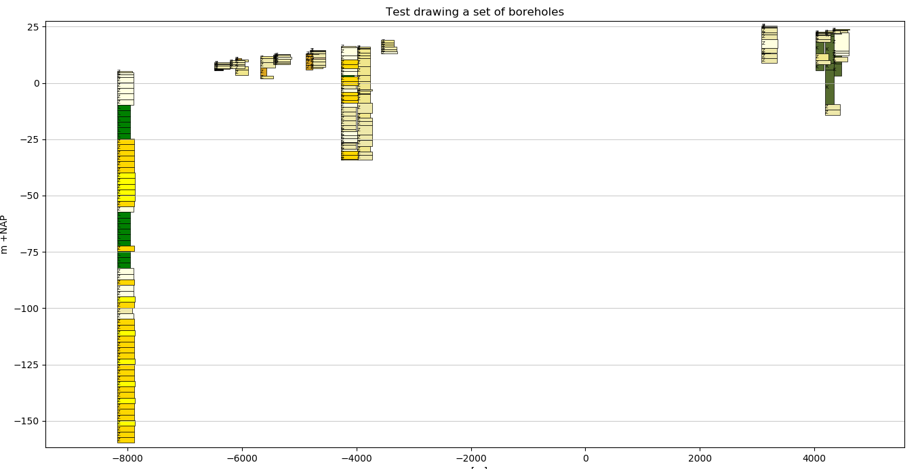

Slide 39
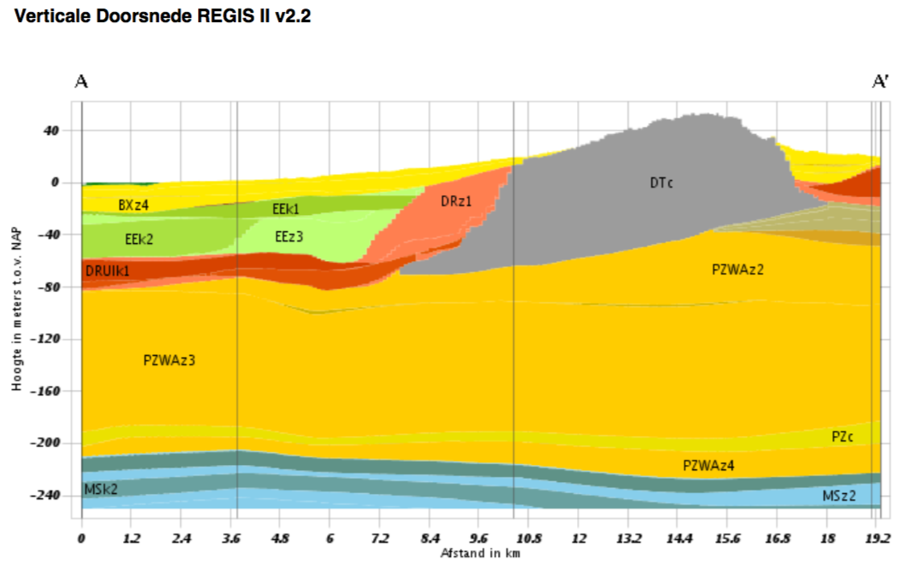

Slide 40
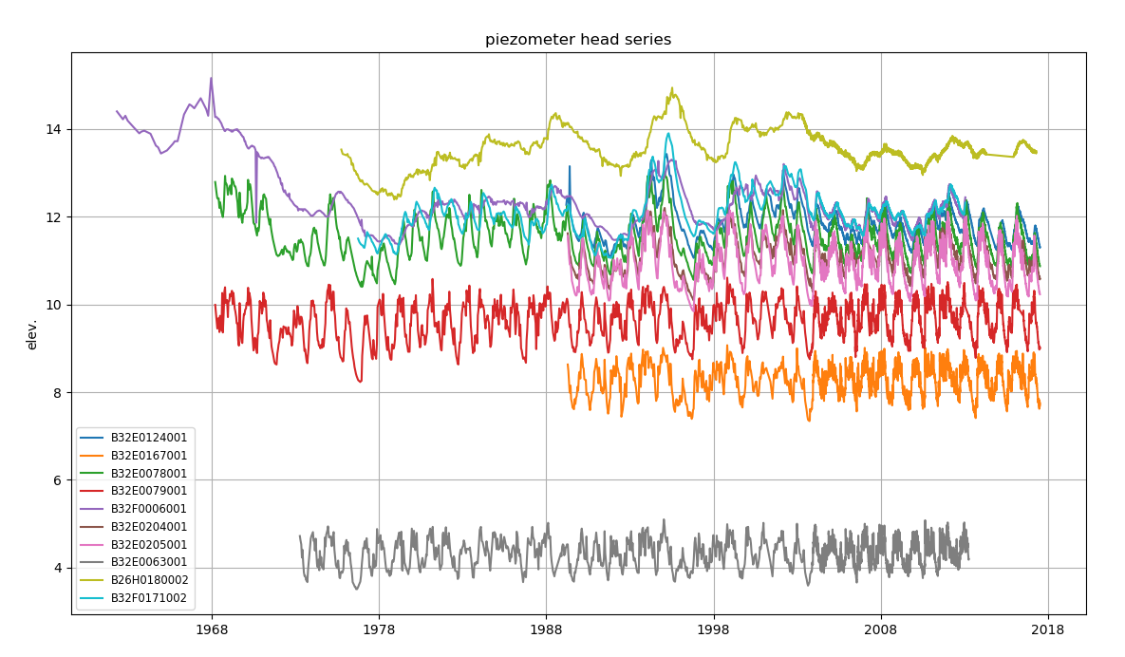

Slide 41
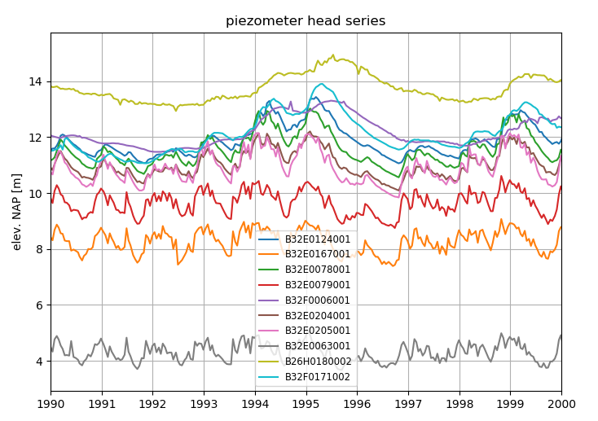

Slide 42
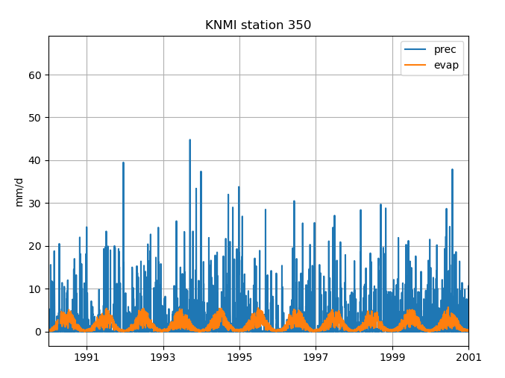

Slide 43
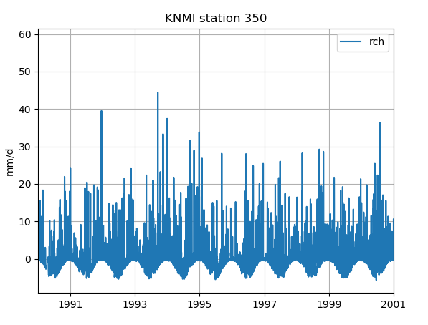

Slide 46
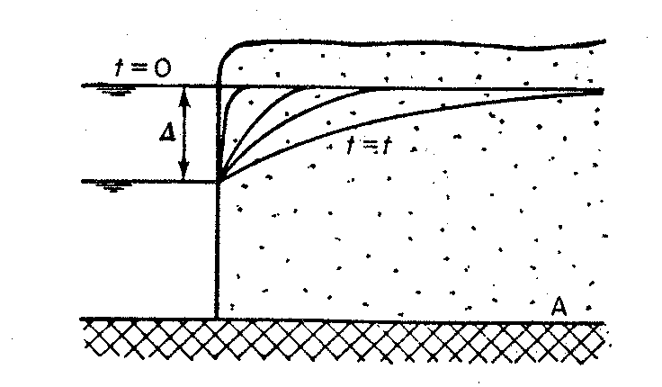
kH
S
x

Slide 49
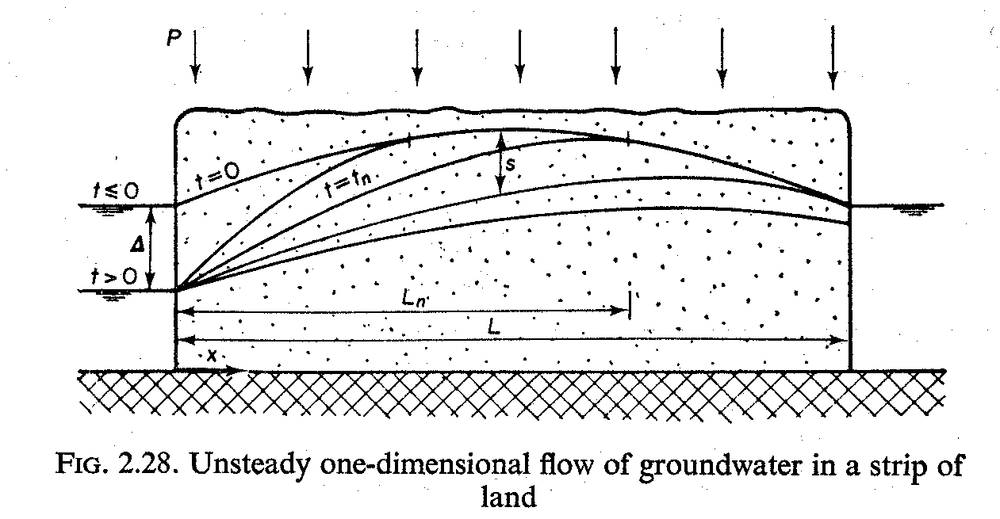
Superposition

Slide 50
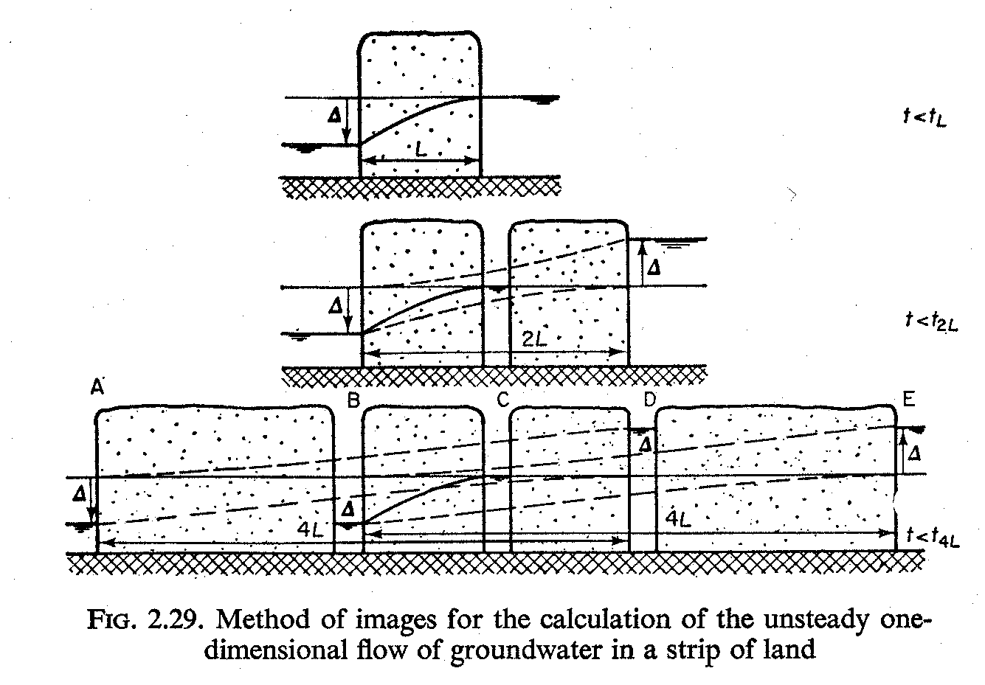

Slide 51
L
a
kD
S
x
x
x
L
A
A
B
B

Slide 52
L
a
b
kD
S
x
a
b
x
L
A
A
B
B

Slide 55
How fast or slow is the groundwater system ??

Slide 56
Convolution superposition in the time domain

Slide 58
Input pulse
Head,
Concentration,
Temperature
or whatever
Output due to pulse = impulse response
t

Slide 59
Continuous input treated as series of pulses
Head,
Concentration,
Temperature
or whatever
Output due to individual pulses
t
Output of individual pulse
outputs superposed yielding
total output
Head,
Concentration,
Temperature
or whatever
t

Slide 60
time
t
time

Slide 61
t
time

Slide 62
t
time

Slide 63
t
time

Slide 64
t
time

Slide 65
Groundwater flow solutions are often step responses
See the two examples we had before:
Sudden change of river level
Sudden start of pumping a well

Slide 66
Step response
Head,
Concentration,
Temperature
or whatever
t

Slide 68
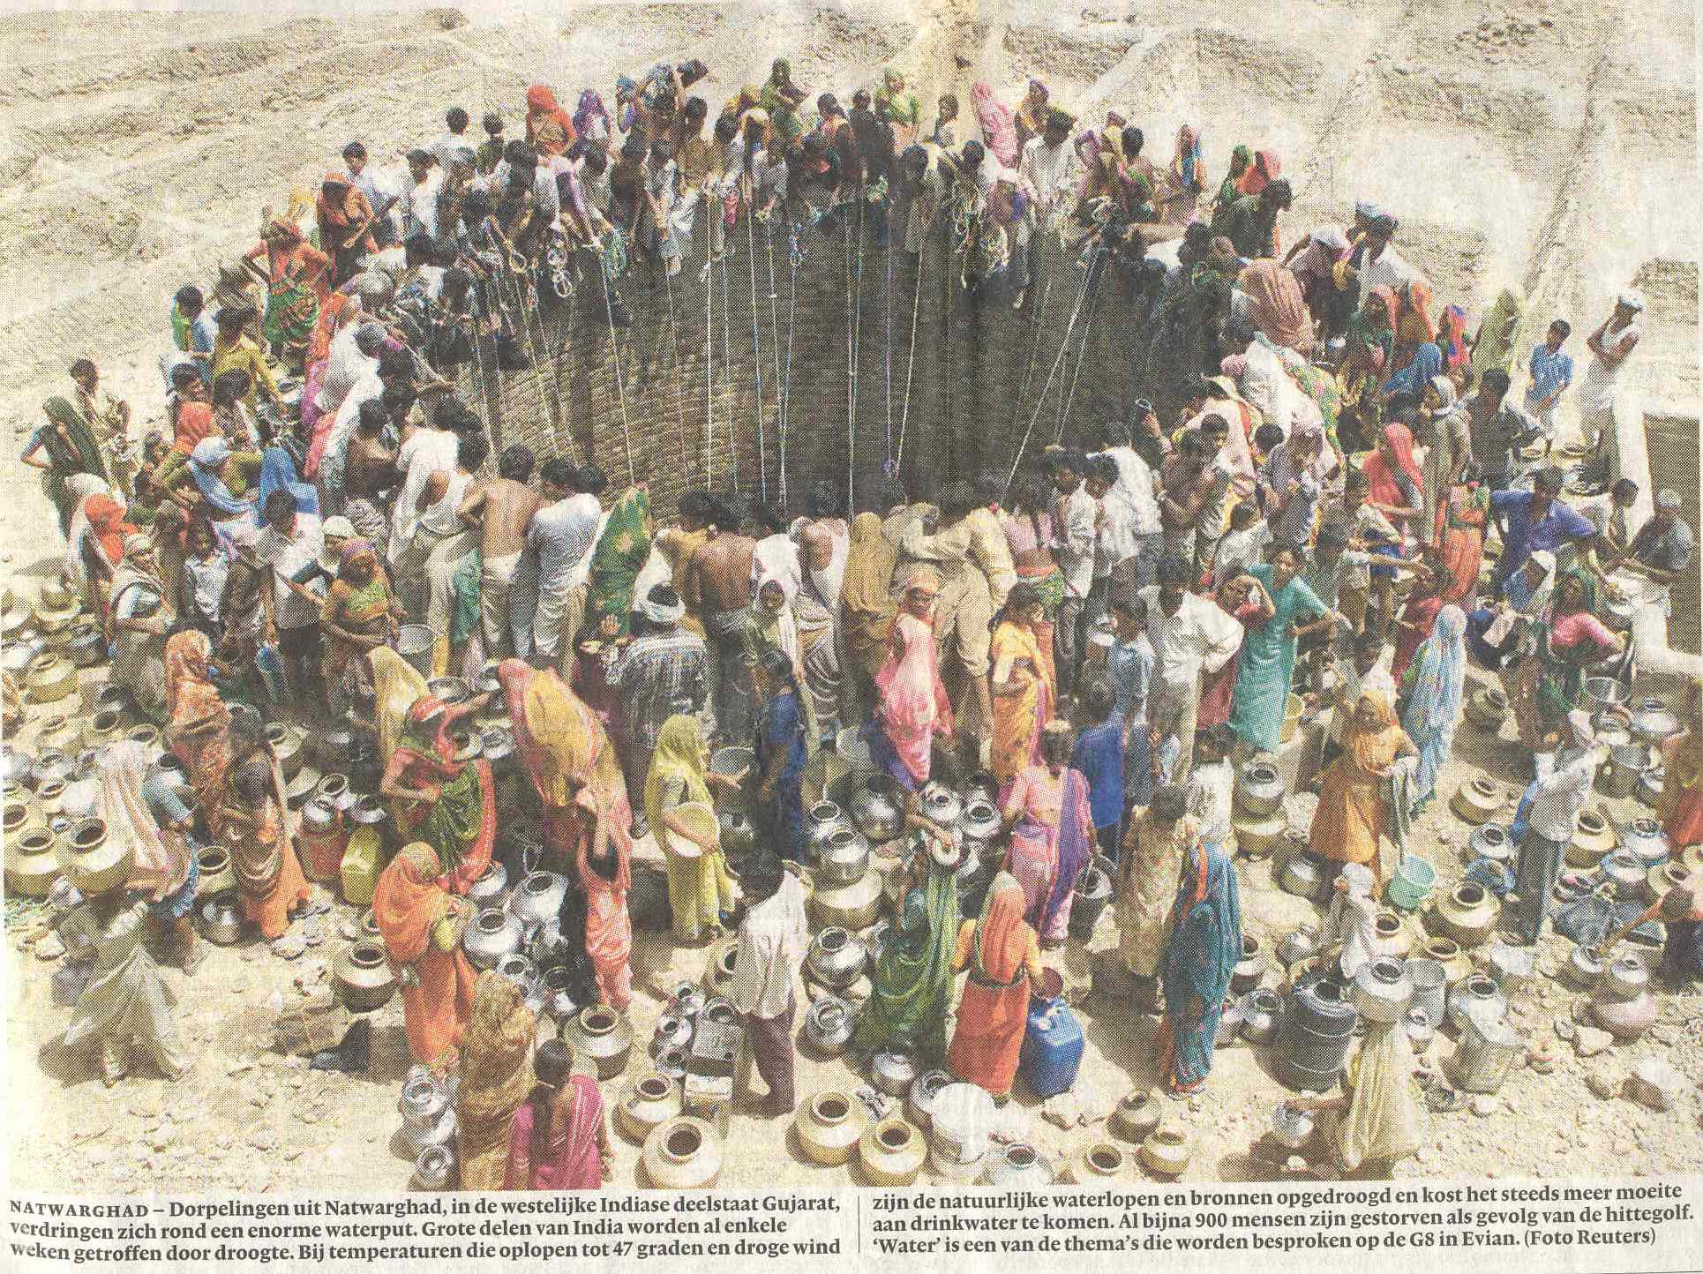
Flow to wells

Slide 70
Situation Hantush
Water from storage + leakage
Situation Theis
All water from storage

Slide 71
Theis all water from storage, here assumed s<<h so that the system remains
almost linear so that Theis can be applied.
Q
s
S_{y}
h
k
r

Slide 72
Theis
Hantush
Initial condition
Head-boundary cond.
Flow-boundary cond.

Slide 73
Theis
Hantush

Slide 74
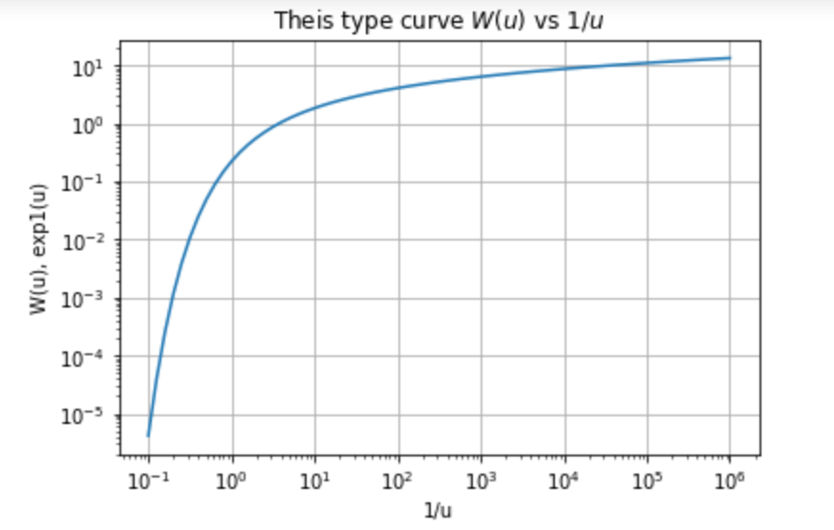

Slide 76
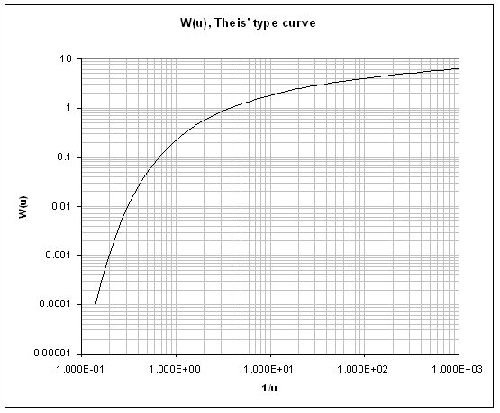
Match point

Slide 77
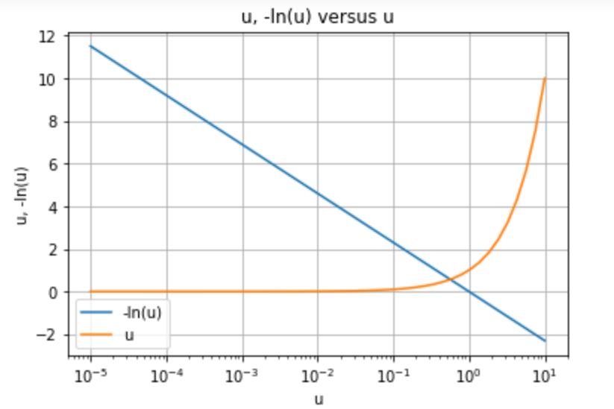

Slide 78
Log approximation of Theis’ well function

Slide 79
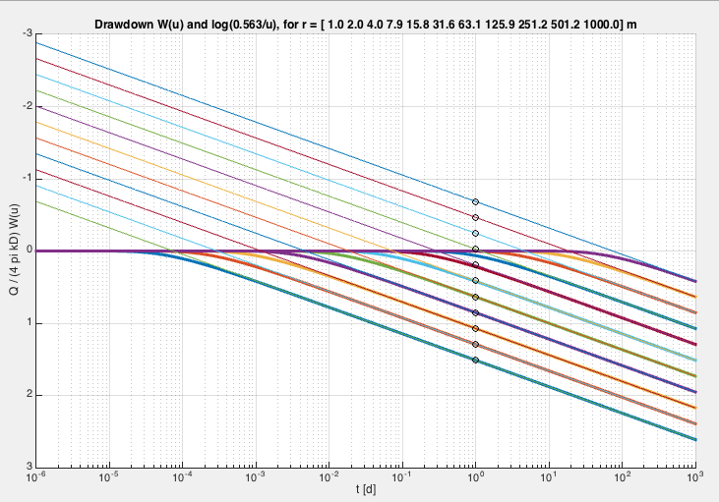
Drawdown as function of t for individual r’s
True (Theis)
Straight-line approximation
Note that the drawdown is drawn downward positive
which is more intuitive.

Slide 80
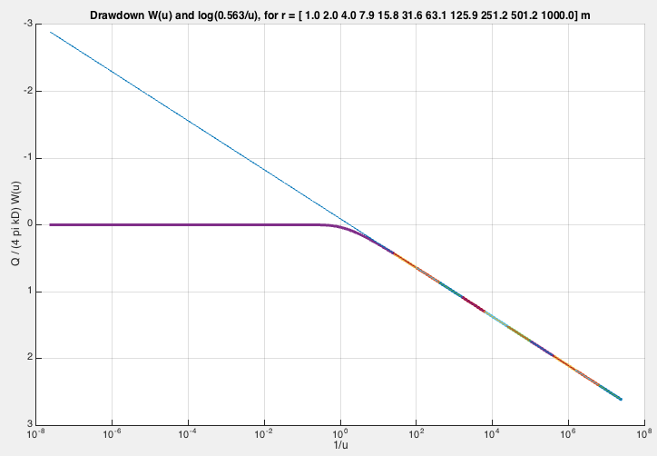
Drawdown as function of 1/u or t/r²
True (Theis)
Straight-line approximation
If all data for all times and distances are
Versus 1/u or t/r², then the lines for all
Piezometers coincide.
1/u or t/r²

Slide 81
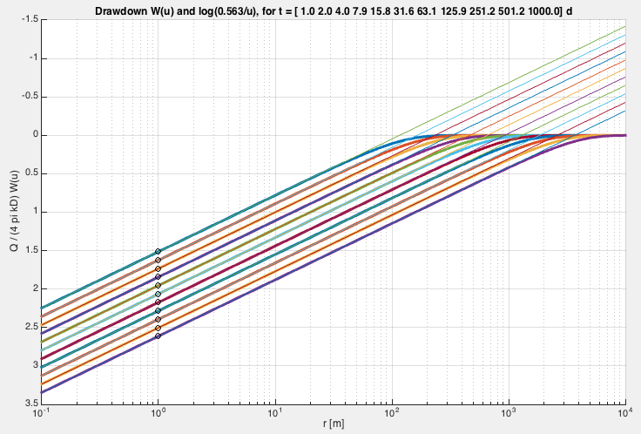
Drawdown as a function of r for inividual t’s
Radius of influence moving out with time
Straight-line approximation
True (Theis)

Slide 82
Radius of influence

Slide 83
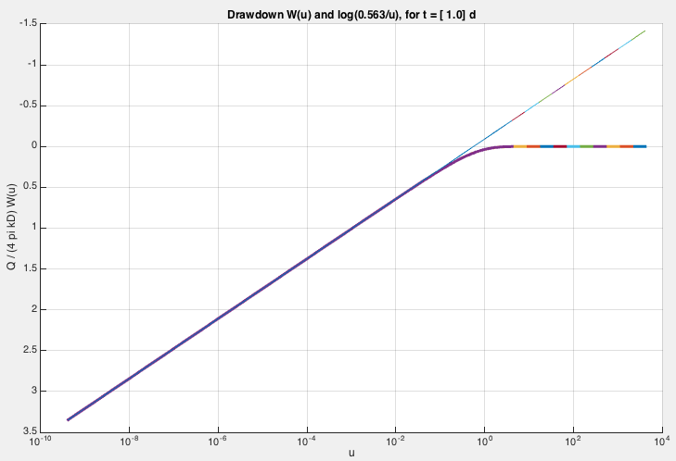
Drawdown as function of u or r²/t
Straight-line approximation
Notice that drawdown points downward
True (Theis)
If all data for all times and distances are
Versus u or r²/t, then the lines for all
Piezometers coincide.
u or r²/t

Slide 84
Switch to 10 base logarithm, useful when using
10-base logarithmic r-axis
The sheet uses previous approximation to interprete
a pumping test

Slide 85
Drawdown per log cycle yields kD
Drawdown 0 with kD now known yields S
Where t₀ is obtained from intesection of the
Straight line portion of the drawdown graph of s versus log(t/r²)

Slide 86
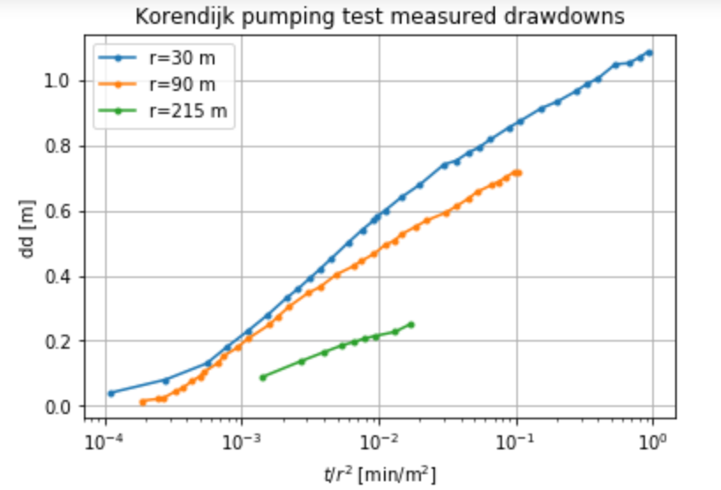
log cycle
t₀
Drawdown per log cycle

Slide 87
Hantush (1956)
Transient radial symmetric flow towards a well
in a semi-confined aquifer
Q
φ
s=φ-φ_{o}
φ_{o}
c
kD
λ²=kDc

Slide 88
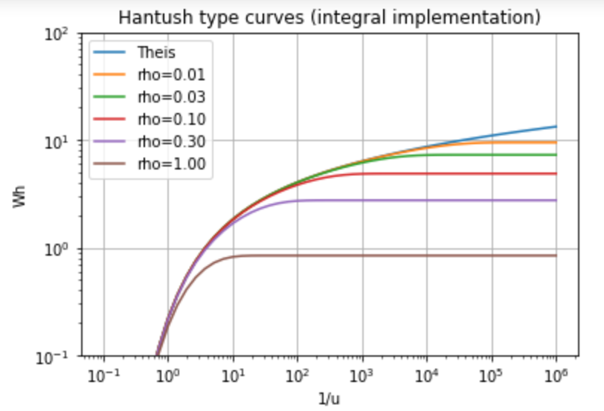

Slide 89
Match point

Slide 90
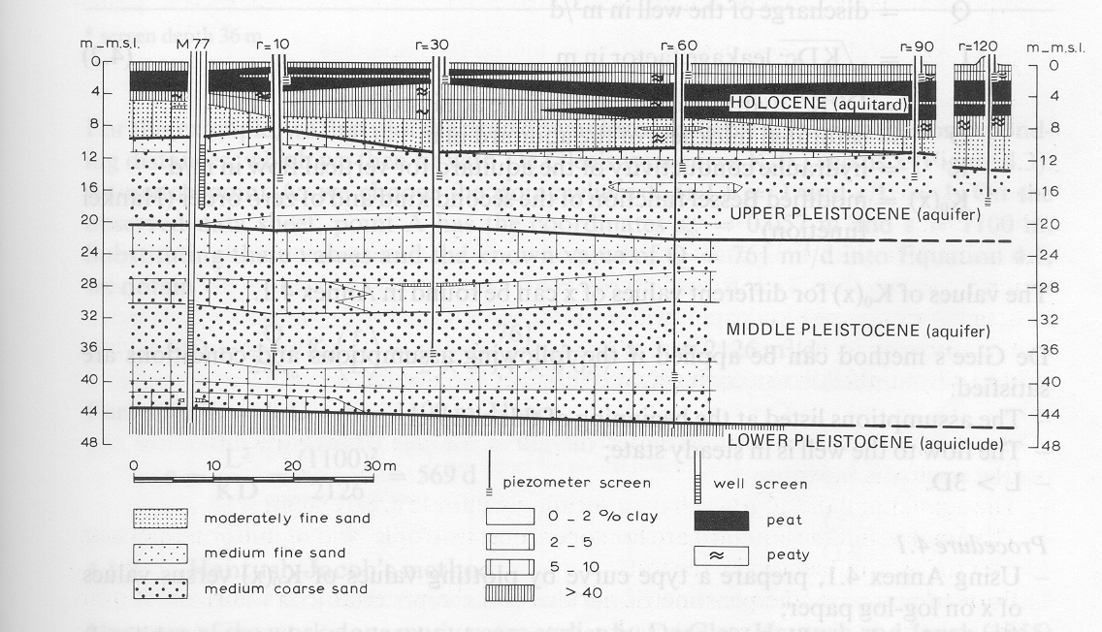

Slide 91
Water from leakage, may gradually lower the water table
Q
s
c
kH
S
r

Slide 92
Measuring from above
Measuring from below
b
a
z
D
a
r
r
b
z

Slide 93
r_{c}
k
r_{w}
h
r

Slide 94
Key questions
Can you derive the elastic storage coefficient of aquifers?
Same for barometric efficiency?
Same for effect of overburden change?
How do barometric efficiency and overburden efficiency relate to each other?
How can specific storage coefficient be derived from measured barometric efficiency?
How does specific storage relate to elastic storage of an aquifer?
Have any idea of values of specific storage found in practice?
Same for specific yield of sand?
What is the dimension of specific yield S_{y}, specific storage S_{s} and elastic storage S?
Which of the two is largest (specific yield or elastic storage, and how much larger?)
For the cracks: could you derive the effect of earth tide on groundwater head?

